Slide 1
Portable Notepad
ITSC 3155 - Final Project
Conner Malloy, Evan Rohrwasser, Gerardo Quintana

Slide 2
Portable Notepad - Introduction
A user wants access to their notes and note taking application on their computer or any computer they use.
Solved with cloud-based applications, but what if the user doesn’t have an internet connection?
Our product intends to be portable and allow a user access to their notes on any computer they use without requiring an internet connection
Users will benefit from a familiar interface and not having to depend on an internet connection

Slide 3
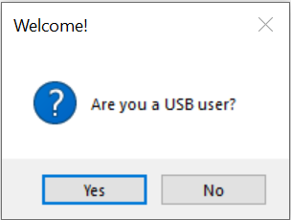
Portable Notepad - Our Solution
Our product provides a solution that is not possible with cloud based applications
Our product allows users to run the application locally or from a USB drive
Our product does not require an internet connection
Our product is simple, familiar and easy to use

Slide 4
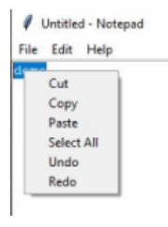
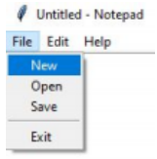
Portable Notepad - Our Solution
Simple and familiar note-taking features:
Cut/Copy/Paste
Select All
Undo/Redo
Save/Open/New
Menu Bar
Right-Click Menu

Slide 5
Portable Notepad - Use Cases
USB User
Local User
This user wants to be able to have a portable application that they can install on their USB drive. The application will create a ‘Notes’ directory on their USB drive where they will be able to open and save their notes.
This user wants to be able to take notes with a simple, easy to use application and save to their device, all without requiring an internet connection

Slide 6
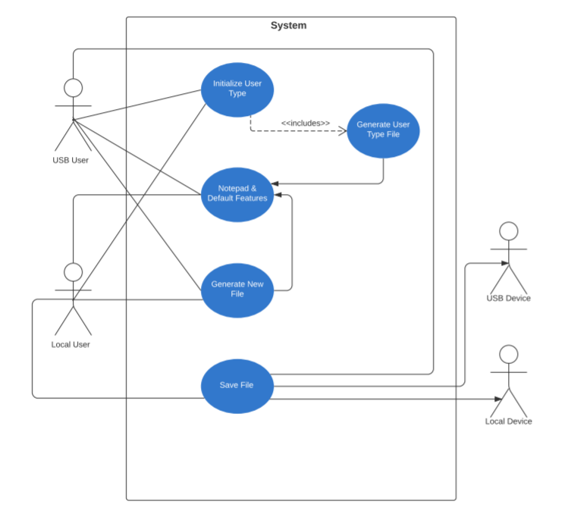
Portable Notepad - Use Case Diagram

Slide 7
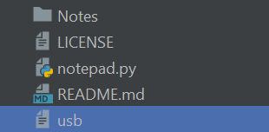
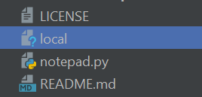
Portable Notepad - Implementation
User Initialization
Store User Type
USB or Local User
‘Notes’ folder is created for USB User and is the default open/save location
Editing features for both users

Slide 8
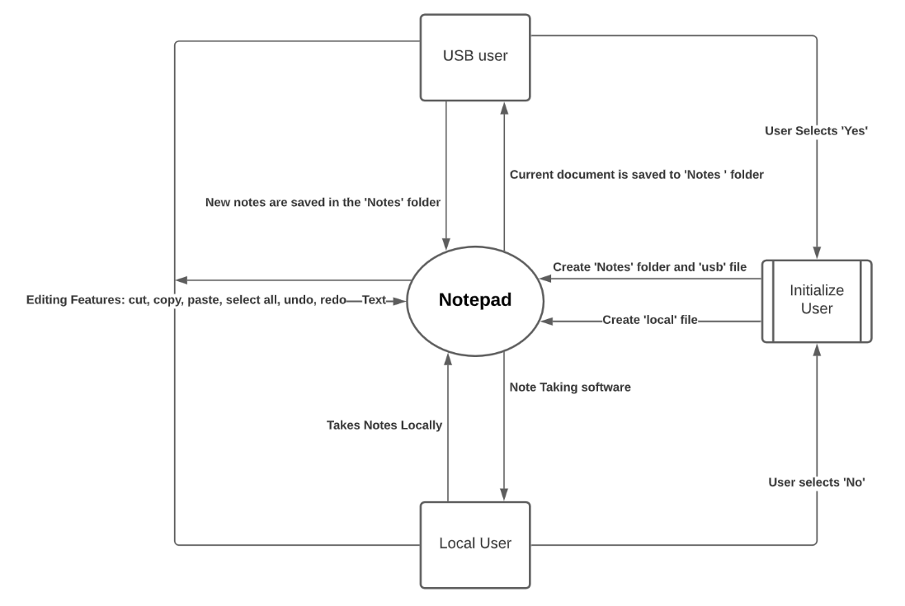
Portable Notepad - Context Diagram

Slide 9
Portable Notepad Demo

Slide 10
Portable Notepad - Conclusion
Challenges
Learning Experience
Challenges we faced were not being able to meet face to face
Knowing everyone’s coding experience
Dividing workload evenly between group members
Meeting projected due dates and adjusting the dates appropriately
Things we learned were how crucial group communication is
How to use git in group setting
The importance of modeling and how certain models have greater value depending on the system
Utilizing open source software and modifying existing code

